Slide 1
Open question answering over curated and extracted knowledge bases
Date: 2014/11/13
Author: Anthony Fader, Luke Zettlemoyer, Oren Etzioni
Source: KDD’14
Advisor: Jia-ling Koh
Speaker: Jim-An Tsai

Slide 2
Outline
Introduction
Method
Experiment
Conclusion

Slide 3
introduction

Slide 4
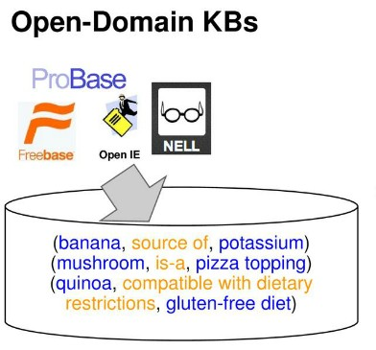
Knowledge Base

Slide 5
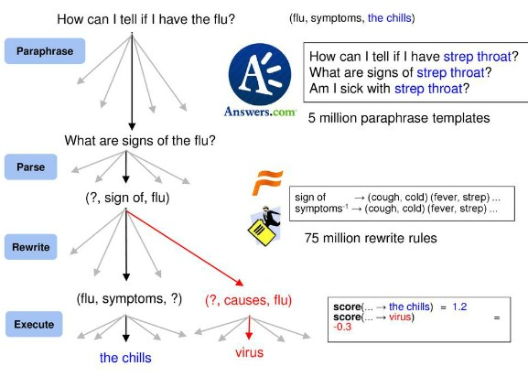
Open question answering (OQA)
OQA automatically mines millions of operators(left) from unlabeled data, then learns to compose them to answer questions(right) using evidence from multiple knowledge bases.

Slide 6
Outline
Introduction
Method
Experiment
Conclusion

Slide 7
Operators and Features
High Precision, Low Recall

Slide 8
Operators and Features
Low Precision, High Recall

Slide 9
Operators and Features
handle the mismatch between natural language vocabulary and the KB vocabulary

Slide 10
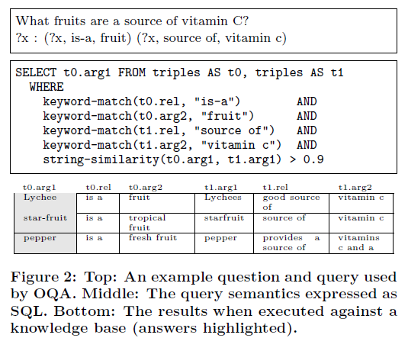
Operators and Features
takes a query as input and returns a set of tuples

Slide 11
Derivation Operators
Ops & States
A derivation d = (o, s, k) consists of a sequence of k operators o = (o1, ……, ok) and a sequence of k+1 states s = (s0, s1, ……, sk) satisfying si ∈ oi(si-1 )for all 1 ≤ i ≤ k.

Slide 12
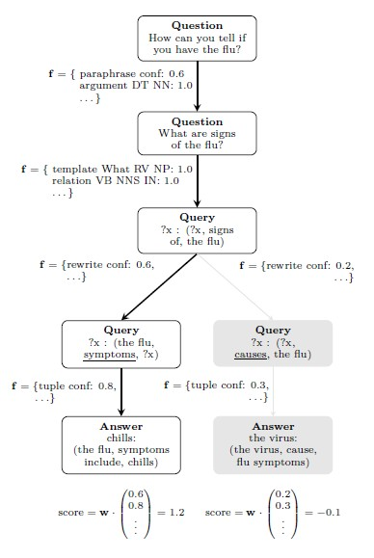
Scoring Function
f is an n-dimensional feature function that maps a derivation step into Rn.
w is an n-dimensional weight
vector.

Slide 13
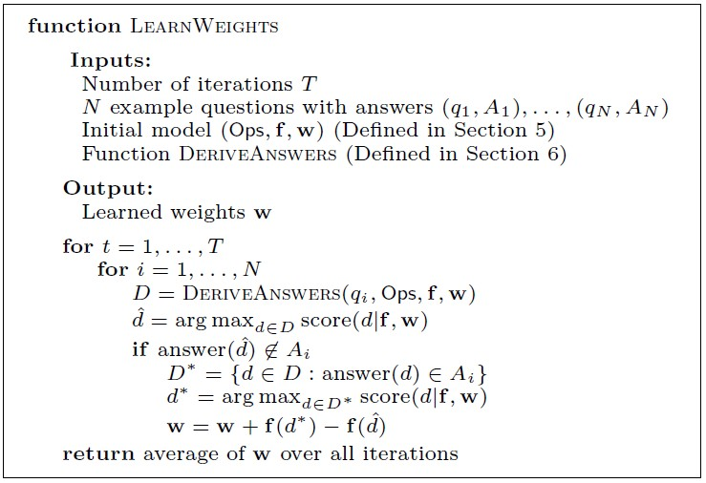
Inference & Learning

Slide 14
Outline
Introduction
Method
Experiment
Conclusion

Slide 15
Experiment

Slide 16
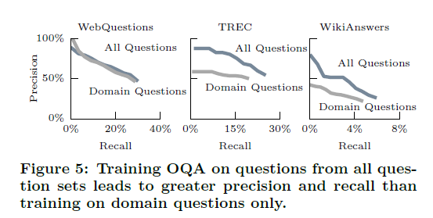
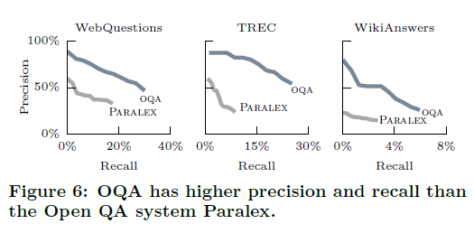
Experiment

Slide 17
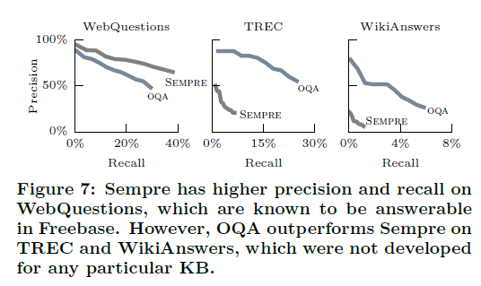
Experiment

Slide 18
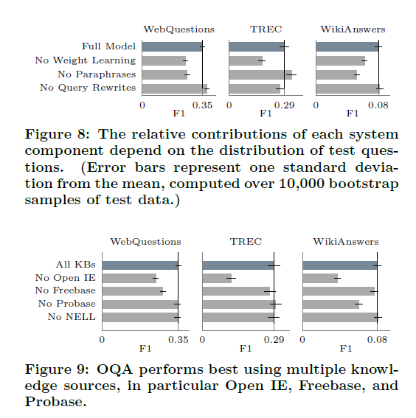
Experiment

Slide 19
Outline
Introduction
Method
Experiment
Conclusion

Slide 20
Conclusion
We introduced OQA, a novel Open QA system that is the first to leverage both curated and extracted knowledge.
We described inference and learning algorithms that OQA use to derive high-confidence answers.
Our experiments demonstrate that oqa generalizes well to unseen questions and makes signficant improvements over a state-of-the-art Open QA baseline.

